Slide 1
DDL Commands Data Definition Language

Slide 2
What is DDL?
DDL is short name of Data Definition Language, defines the database structure or database schema.
DDL also defines additional properties of the data defined in the database, as the domain of the attributes.
The Data Definition Language also provide the facility to specify some constraints that would maintain the data consistency.

Slide 3
DDL Commands
CREATE - to create a database and its objects like (table, index, views, store procedure, function, and triggers)
ALTER - alters the structure of the existing database
DROP - delete objects from the database
TRUNCATE - remove all records from a table, including all spaces allocated for the records are removed
RENAME - rename an object

Slide 4
DDL Commands
CREATE - to create a database and its objects like (table, index, views, store procedure, function, and triggers)
ALTER - alters the structure of the existing database
DROP - delete objects from the database
TRUNCATE - remove all records from a table, including all spaces allocated for the records are removed
RENAME - rename an object
DDL statements automatically commit the current transaction; they cannot be rolled back.

Slide 5
Create Command
This command is used to create database & its objects. There are two common CREATE statements available in SQL:
CREATE DATABASE
CREATE TABLE

Slide 6
Create Database
A Database is defined as a structured set of data. So, in SQL the very first step to store the data in a well-structured manner is to create a database. The CREATE DATABASE statement is used to create a new database in SQL.

Slide 7
Create Database
A Database is defined as a structured set of data. So, in SQL the very first step to store the data in a well-structured manner is to create a database. The CREATE DATABASE statement is used to create a new database in SQL.
Syntax:
CREATE DATABASE database_name;

Slide 8
Create Table
The CREATE TABLE statement is used to create a table in SQL. We know that a table comprises of rows and columns. So while creating tables we have to provide all the information to SQL about the names of the columns, type of data to be stored in columns, size of the data etc. Let us now dive into details on how to use CREATE TABLE statement to create tables in SQL.

Slide 9
Create Table – Syntax
CREATE TABLE table_name ( column1 data_type(size), column2 data_type(size), column3 data_type(size), . . . );

Slide 10
Create Table – Example
CREATE TABLE table_name ( column1 data_type(size), column2 data_type(size), column3 data_type(size), . . . );
CREATE TABLE patient ( ID INT(11), name VARCHAR(30), phone VARCHAR(15) );

Slide 11
SQL Datatypes
String Datatypes
Numeric Datatypes
Date and Time Datatypes

Slide 12
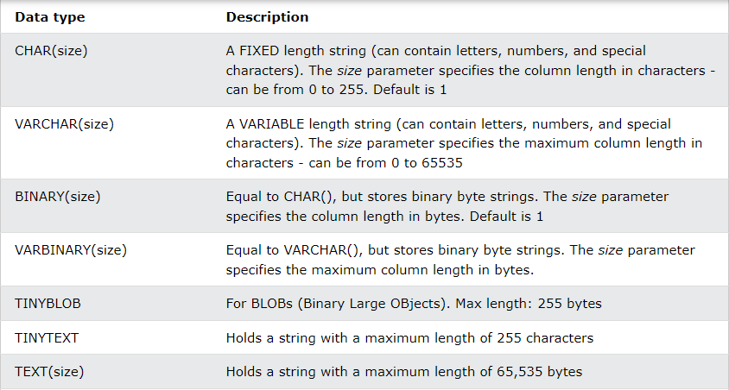
String Datatypes

Slide 13
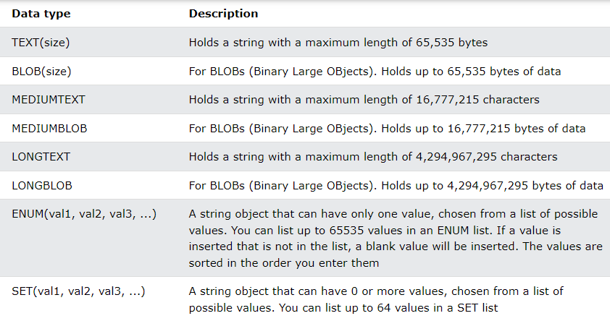
String Datatypes

Slide 14
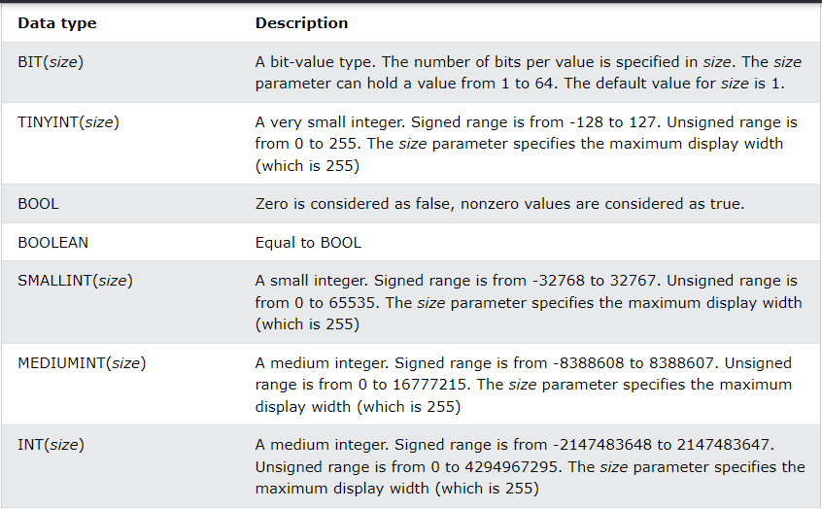
Numeric Datatypes

Slide 15
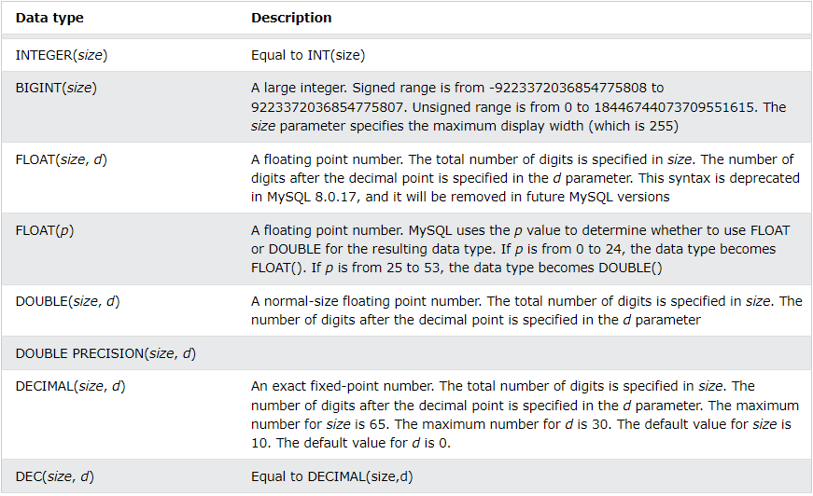
Numeric Datatypes

Slide 16
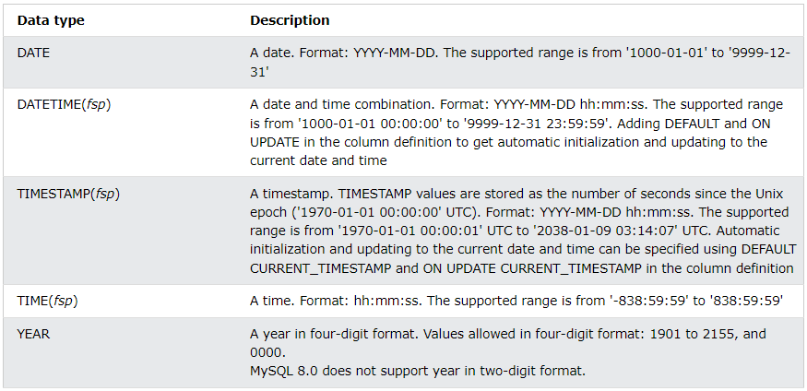
Date-Time Datatypes

Slide 17
Alter Command
alter command is used for altering the table structure, such as,
• to add a column to existing table
• to rename any existing column
• to change datatype of any column or to modify its size.
• to drop a column from the table

Slide 18
Alter Command – Add a New Column
ALTER TABLE table_name ADD(column_name datatype);
Here is an Example for this,
ALTER TABLE student ADD(
address VARCHAR(200)
);
The above command will add a new column address to the table student, which will hold data of type varchar which is nothing but string, of length 200.

Slide 19
Alter Command – Add Many New Column
ALTER TABLE table_name ADD(
column_name1 datatype1,
column-name2 datatype2,
column-name3 datatype3);
Here is an Example for this,
ALTER TABLE student ADD(
father_name VARCHAR(60),
mother_name VARCHAR(60),
dob DATE);
The above command will add three new columns to the student table

Slide 20
Alter Command – Add New Column with Default Value
ALTER TABLE table_name ADD(
column-name1 datatype1 DEFAULT some_value
);
Here is an Example for this,
ALTER TABLE student ADD(
dob DATE DEFAULT '01-Jan-99'
);
The above command will add a new column with a preset default value to the table student

Slide 21
Alter Command – Modify a Column
ALTER TABLE table_name modify(
column_name datatype
);
Here is an Example for this,
ALTER TABLE student MODIFY
address varchar(300);
Remember we added a new column address in the beginning? The above command will modify the address column of the student table, to now hold upto 300 characters.

Slide 22
Alter Command – Modify Multiple Columns
ALTER TABLE table_name
modify column_name datatype,
modify column_name2 datatype;
Here is an Example for this,
ALTER TABLE student
modify father_name VARCHAR(70),
modify mother_name VARCHAR(70);
The above command will modify the father_name & mother_name column of the student table, to now hold upto 70 characters.

Slide 23
Alter Command – Rename a Column
ALTER TABLE table_name CHANGE COLUMN
old_column_name new_column_name datatype;
Here is an example for this,
ALTER TABLE student CHANGE COLUMN
address location VARCHAR(20);
The above command will rename address column to location.

Slide 24
Alter Command – Drop a Column
ALTER TABLE table_name DROP
column_name;
Here is an example for this,
ALTER TABLE student DROP
address;
The above command will drop the address column from the table student

Slide 25
Alter Command – Drop Multiple Columns
ALTER TABLE table_name
DROP column_name,
DROP column_name2;
Here is an example for this,
ALTER TABLE student
DROP address,
DROP phone;
The above command will drop address & phone column from the table student

Slide 26
Drop Command
DROP DATABASE command is used to drop or remove SQL database. Following is the syntax,
DROP DATABASE database_name;
Note: Be careful before dropping a database. Deleting a database will result in loss of complete information stored in the database!

Slide 27
Drop Command – Delete Object from Database
DROP TABLE command is used to drop or remove table from database.
Following is the syntax,
DROP TABLE table_name;
Drop column is already covered in alter command section.

Slide 28
Truncate Command
The TRUNCATE TABLE command deletes the data inside a table, but not the table itself.
Following is the syntax,
TRUNCATE TABLE table_name;

Slide 29
Rename Command
The rename command is used to change the name of an existing database object(like Table,Column) to a new name.
Renaming a table does not make it to lose any data is contained within it.
Following is the syntax,
RENAME TABLE current_name TO new_name;
You can also use command to rename a table name:
ALTER TABLE current_name RENAME new_name;

Slide 30
Note: RENAME TABLE, unlike ALTER TABLE, can rename multiple tables within a single statement: RENAME TABLE does not work for TEMPORARY tables. However, you can use ALTER TABLE to rename temporary tables. RENAME TABLE works for views, except that views cannot be renamed into a different database.

